Slide 1
MCNAIR SECONDARY GRADE 12 GRADUATION & POST-SECONDARY INFORMATION NIGHT
2025-2026

Slide 2
AGENDA:
2200
Vice Principal’s Welcome and Introductions
Grad Events
Graduation Program Requirements
Post Secondary Options
Admissions
Application Process
Finances
Information Finding
Questions and Contacts

Slide 3
Grad Events
Grad Kick-Off Event – September 12
Autumn Gala
Commencement (Chan Centre at UBC) – June 15
Dinner Dance – June 23

Slide 4

THE GRAD PROGRAM

Slide 5
BC GRADUATION REQUIREMENTS
Overview
Each completed course earns 4 credits
80 credits required to graduate, including specific courses
Each of the GRADUATION REQUIRMENTS must be completed to earn a Dogwood Certificate
Post-Secondary Programs have additional requirements (ADMISSION REQUIREMENTS)

Slide 6
Your Grad Requirements
Overview
80 credits MINIMUM
48 Required courses
28 Elective courses
4 classes at Grade 12 level
1 class of Fine Arts/Applied Skills
2 Career Life courses (CLE 10, Capstone 12)
Indigenous-focused credit
GNA 10, GLA 10 & GLA 12

Slide 7
Graduation Requirements
Grade 10 | Grade 11 | Grade 12
1. EN 10: Composition & Focussed Literary Studies 10 | 1. English Studies 11 | 1. English Studies 12
2. Socials 10 | 2. a Socials 11/12 | 2. Elective 12
3. Math 10 | 3. a Math 11 | 3. Elective 12
4. Science 10 | 4. a Science 11 | 4. Elective 12
5. PHE 10 | 5. Career Life Education 10 | 5. Elective
6. Elective | 6. Elective | 6. Elective
7. Elective | 7. Elective | 7. Elective
8. Elective | 8. Elective | 8. Elective
2 Alternative Choices | 2 Alternative Choices | 2 Alternative Choices

Slide 8
MANDATORY GR. 12 REQUIREMENTS
English Studies 12
Elective 12
Elective 12
Elective 12
Indigenous-Focused credit
Met through English First Peoples 12
Career Life Connections + Capstone
An Arts 10/11/12 or an Applied Skills 10/11/12
GNA 10, GLA 10, GLA 12

Slide 9
Career Life Connections
A graded course and successful completion is a requirement for graduation
Self-directed course (over RVS) with periodic meetings in person
2 parts to this course:
1. The CLC coursework (2 credits)
Short term and long term (career, educational, personal) goals
Current resume
30 hr. Volunteer/Work Experience Log and Reflection
Reflection Journal Entries
2. The Capstone Project (2 credits)
A passion project that students work on throughout the year, culminating in a presentation to teachers
Notes:
Small assignments handed in, receive feedback from teachers

Slide 10
Grad Literacy/Numeracy Assessments
All students must complete the following:
GNA 10
Most students complete this in Grade 10
GLA 10
Most students complete this in Grade 10
GLA 12
This will be completed this year

Slide 11
Post-Secondary Requirements

Slide 12
Research
Important to consider what you wish to pursue
Requirements for programs at colleges/universities, trade schools etc
Useful Tools
My Blueprint www.myBlueprint.ca/sd38
Education Planner https://www.educationplannerbc.ca/
Who Am I Quizzes
Post-Secondary Search Tool
Job Profiles and Employment Outlook
Resume, Cover letters, Job search tools and more

Slide 13
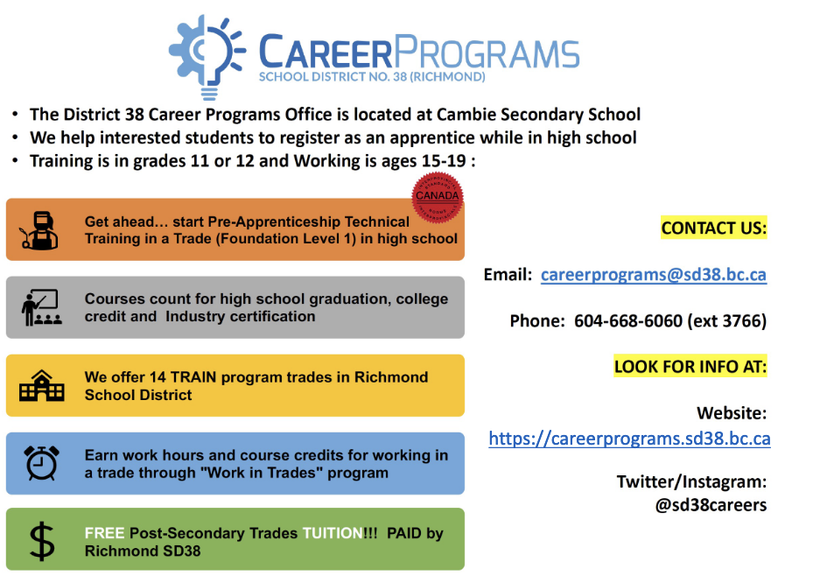
INTERSTED IN TRADES?

Slide 14
UNIVERSITY, COLLEGE,OTHER?

Slide 15
Post-Secondary Institutions Explained
UNIVERSITIES – offer undergraduate (bachelor’s) degrees, as well as graduate (master’s or doctoral) programs.
COLLEGES – Offer academic subjects similar to universities. Some offer bachelor’s degrees and associate degrees, whose credits can be transferred to universities. Colleges also offer full-time and part-time diploma and certificate programs in career, trades and upgrading programs.
TECHNICAL INSTITUTES – offer specialized programs such as trades & technology, and Career related programs.
Each institution has their own general admission requirements. Different programs can have additional requirements.

Slide 16
WHAT DOES IT TAKE TO BE OFFERED ADMISSION?

Slide 17
TYPICAL UNIVERSITY CORE COURSES/REQUIREMENTS
English 12
Some of the core courses taken in grade 11 and 12
Geography
Biology
Chemistry
Physics
Social Justice
Law
History
Pre-Calculus
French, Japanese, Mandarin, others
Calculus

Slide 18
UNIVERSITY ADMISSIONS
High school Graduation
Apply before the stated deadline
Personal Profile/Statement, Video Interview etc. (depending on program and/or school)
English 12
Language Requirements - proficiency in a 2nd language – no longer required at UBC and SFU
5+ additional academic courses (variable)
Institution-specific (min grades in certain subjects)
Program specific (completion of specific 11 and 12 subjects eg. Faculty of Science or Engineering)
Competitive G.P.A. (AVERAGE ) based on Eng 12 & other courses depending on the program
Creates your Ranking

Slide 19
COLLEGE ADMISSIONS
High school Graduation or Equivalent
English 12
Arts & Science and University Transfer may require specific Grade 11/12 subjects
Upgrading options available
Apply Early! First Come First ServeExceptions will be made

Slide 20
WHAT KIND OF GRADES DO I NEED TO BE OFFERED ADMISSION?
?

Slide 21
UNIVERSITY ADMISSION AVERAGES
Each institution sets its own grades
Admission is competitive and varies by program and by year
Some institution may require a minimum in certain grade 11 and/or 12 subjects such as Math and English 12
67% to 70% is generally the minimum to apply to an institution
Competitiveness fluctuates depending on the applicant pool

Slide 22

VANCOUVER
UBC considers grades in all academic courses in Gr 11 and 12, paying special attention to degree specific courses.
Engineering | 90
Arts | 91
Business | 94
Kinesiology | 92
Land & Food Systems | Mid to High 80’s
Music | 91
Science | 95

Slide 23
OKANAGAN
UBC considers grades in all academic courses in Gr 11 and 12, paying special attention to degree specific courses.
Engineering | 90
Arts | 85
Fine Arts | 88
Human Kinetics | 85
Management | 85
Nursing | 90
Science | 87
Engineering | Mid 80’s
Arts | Low to Mid 80’s
Fine Arts | minimum 67
Human Kinetics | Low to Mid 80’s
Management | Mid 80’s
Nursing | High 80’s to Low 90’s
Science | High 80’s

Slide 24
All approved Gr 11 & 12 courses used in calculation. Greater emphasis put on program specific courses.
Arts & Social Sciences Low to Mid 80’s
Communication Low 80’s
Business High 80’s to Low 90’s
Engineering High 80’s to Low 90’s
Science High 80’s

Slide 25
Business | 80%↑
Engineering | 82%↑
Fine Arts | 70%↑
Humanities | 75%↑
Science | 80%↑
Social Sciences | 78%↑
Averages calculated on Gr 12 Courses required for program specific entry.

Slide 26
APPLICATION PROCESS

Slide 27
ONLINE APPLICATION PROCESS
Apply to multiple schools
keep options open
consider a college transfer
many programs are very competitive
Applications require a fee for processing which is non-refundable

Slide 28
WHAT DO I NEED TO APPLY?
Demographic information
Name, PEN#, phone number, etc.
Grade 11 & 12 information
Credit Card

Slide 29
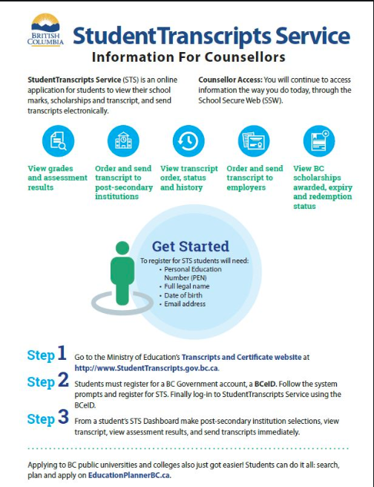
Student transcript service https://www2.gov.bc.ca/gov/content/education-training/k-12/support/transcripts-and-certificates

Slide 30





HOW TO APPLY

Slide 31
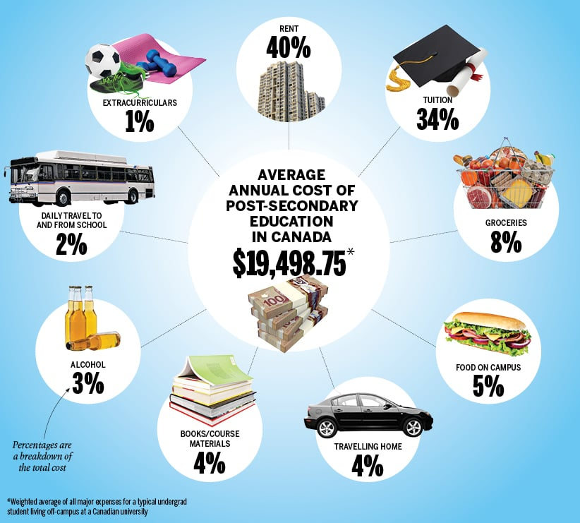
What Does It Cost?

Slide 32
TUITION BREAKDOWN
University
Approximately $8,000 per year plus books, student fees
Living on campus will increase your costs by another $7,000
College
Approximately $2800 per year for University transfer courses
Career programs costs will vary according to the program
Technical Institute
Approximately $6000 per year for a 2 year diploma
Approximately $3400 for a 3-6 month certificate
Approximately $5580 for a 7-12 month certificate
Approximately $830 for a 6 week apprenticeship training
Approximately $6700 for a full time degree program

Slide 33
FINANCING

Slide 34
National Student Loans Service Centre (NSLSC)
Recommended that students apply at least 2 months before their program start date
https://www.csnpe-nslsc.canada.ca/en/home

Slide 35
SCHOLARSHIPS - DEFINED
University/College Entrance
External - Community Based
School Nominated – Select “Students” on McNair Website – choose “Career Centre Information” (at the very bottom!)
Applications are comprehensive, often requiring reference letters, nominations, essays and transcripts

Slide 36
SCHOLARSHIP INFORMATION- WHERE TO LOOK
Scholarshipscanada.com
StudentAwards.com
https://scholartree.ca/
Career Centre on McNair website https://mcnair.sd38.bc.ca/students/career-centre-information
Companies/Employers
Check with employer to see if they
offer any scholarships

Slide 37
CONCLUSIONS
Be Prepared
Know deadlines
Check information sources often

Slide 38
Upcoming Important Events
Post Secondary Institutes (PSBC) Day Friday November 21 from 9:30 -11:30am
SEPT 29/25 CUE (Canadian Universities Event) from 6-8pm at Burnaby Delta Hotels 4331 Dominion Street Burnaby V5G 4L7

Slide 39
Resources
Ten Things Parents Should Know About Post-Secondary: https://www.postsecondarybc.ca/wp-content/uploads/2018/09/for-parents_10-things-parents-need-to-know.pdf
Post-Secondary BC https://www.postsecondarybc.ca/
University Study Canada: https://www.universitystudy.ca/
MacLean’s University Guide (Includes Rankings): https://www.macleans.ca/
Use my website to view upcoming events on our calendar
https://mcnair.sd38.bc.ca/students/career-centre-information

